Slide 1
What is Vanishing Point & Horizon Line
MiaoDX 缪东旭
miaodx@hotmail.com dongxu.miao@horizon.ai

Slide 2

REF1.
https://courses.cs.washington.edu/courses/cse576/08sp/lectures/Projective.ppt

Slide 3
Vanishing points
image plane
vanishing point v
camera
center
C
line on ground plane
Vanishing point
projection of a point at infinity

Slide 4
Vanishing points
image plane
vanishing point v
camera
center
C
line on ground plane
line on ground plane
Properties
Any two parallel lines have the same vanishing point v
The ray from C through v is parallel to the lines
An image may have more than one vanishing point
in fact every pixel is a potential vanishing point
Notes:
How to determine which lines in the scene vanish at a given pixel?

Slide 5
Vanishing lines
v₁
v₂
Multiple Vanishing Points
Any set of parallel lines on the plane define a vanishing point
The union of all of vanishing points from lines on the same plane is the vanishing line
For the ground plane, this is called the horizon

Slide 6
Vanishing lines
Multiple Vanishing Points
Different planes define different vanishing lines

Slide 7
Computing vanishing points
V
P₀
D

Slide 8
Computing vanishing points
V
P₀
D
Properties
P∞ is a point at infinity, v is its projection
They depend only on line direction
Parallel lines P₀ + tD, P₁ + tD intersect at P∞

Slide 9
Computing the horizon
C
l
ground plane
Properties
l is intersection of horizontal plane through C with image plane
Compute l from two sets of parallel lines on ground plane
All points at same height as C project to l
points higher than C project above l
Provides way of comparing height of objects in the scene

Slide 10

REF2.
https://inst.eecs.berkeley.edu/~ee290t/fa11/lectures/October%2025%20vanishing%20points%20and%20line.pptx

Slide 11
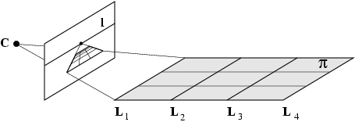
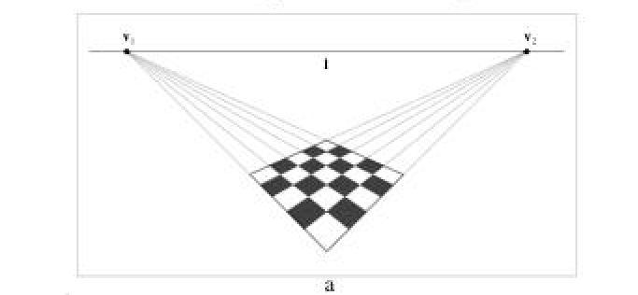
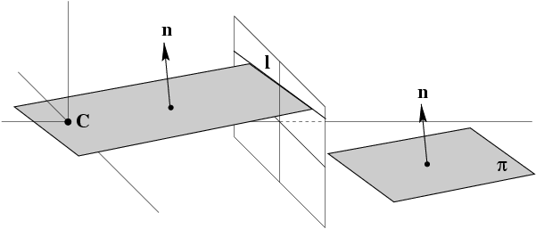
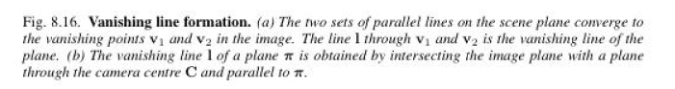
Vanishing lines

Slide 12
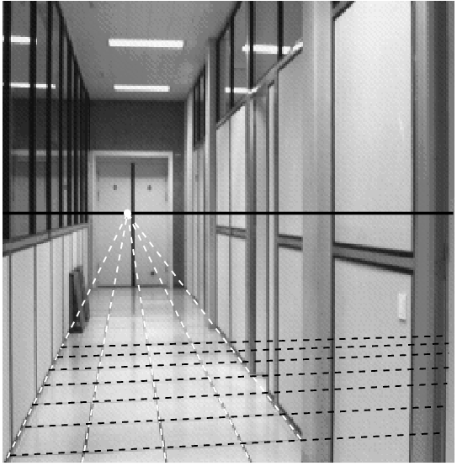
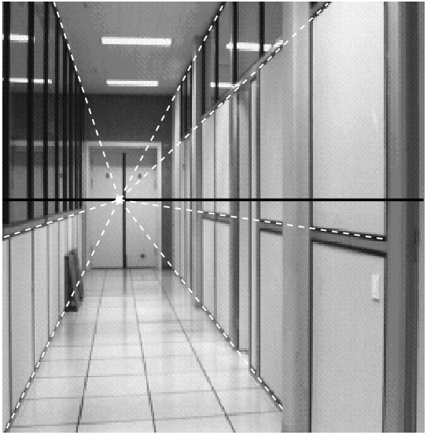
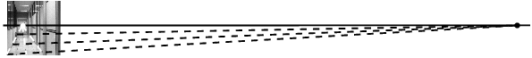
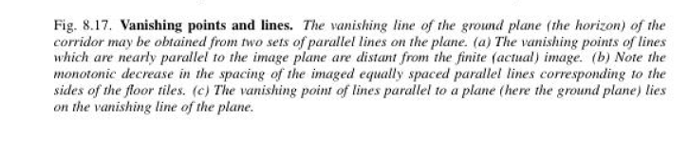
B c
a
Vanishing point of a line parallel to a plane lies on the vanishing line of the plane

Slide 13
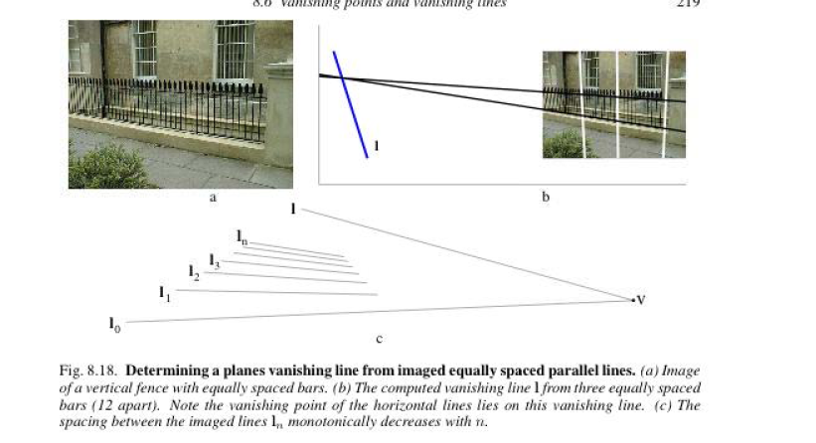
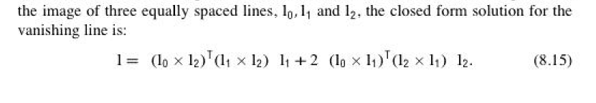

Slide 14
Demos

Slide 15

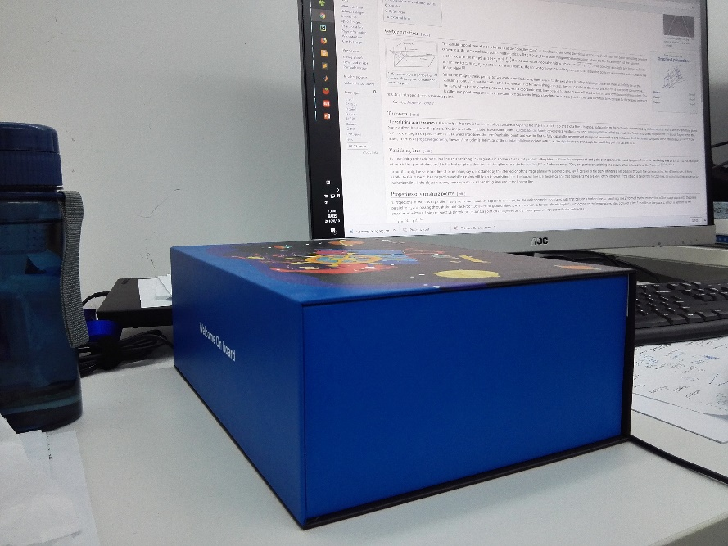

Slide 16
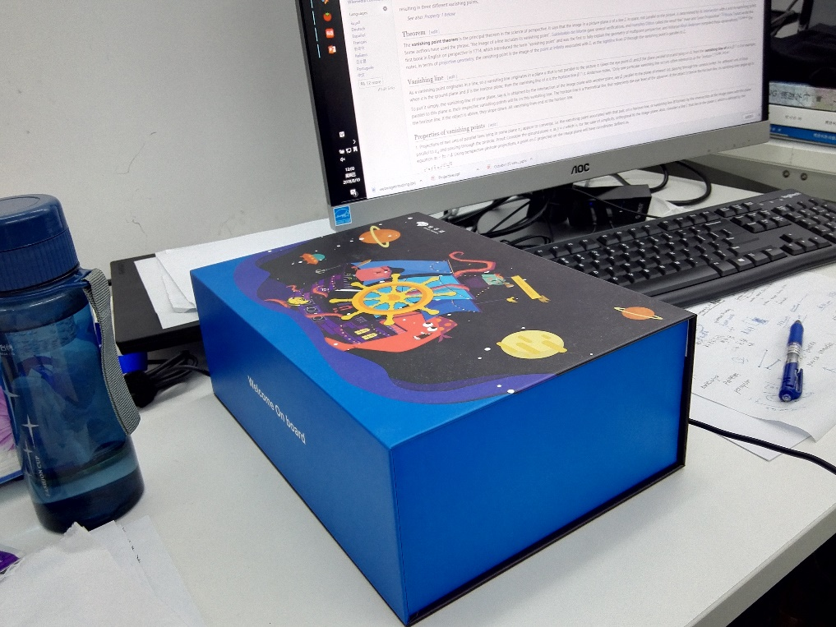

Slide 17
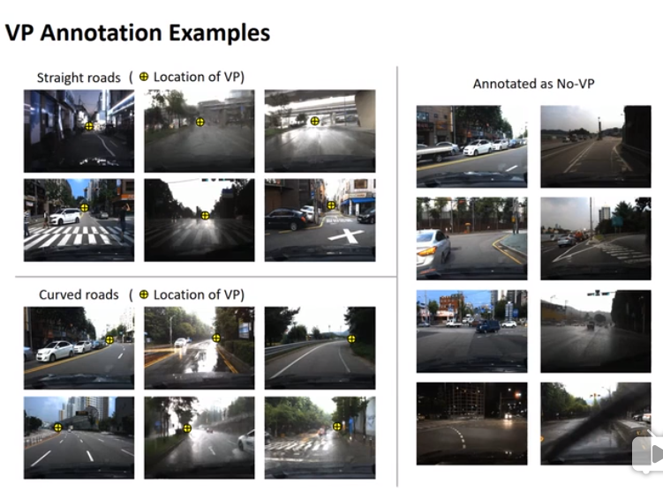
VPGNet annotation

Slide 18
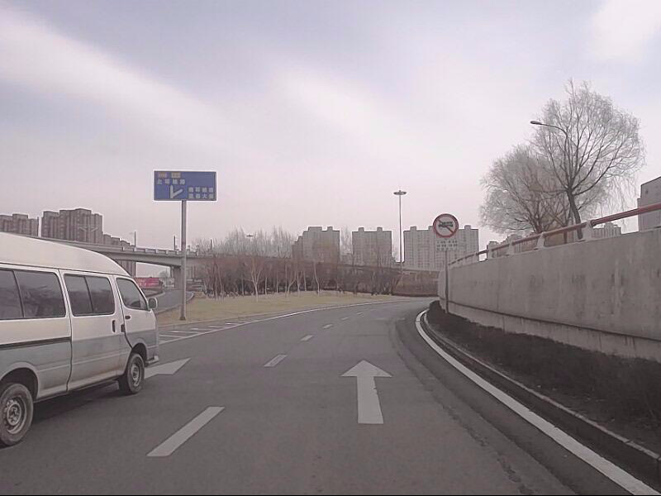
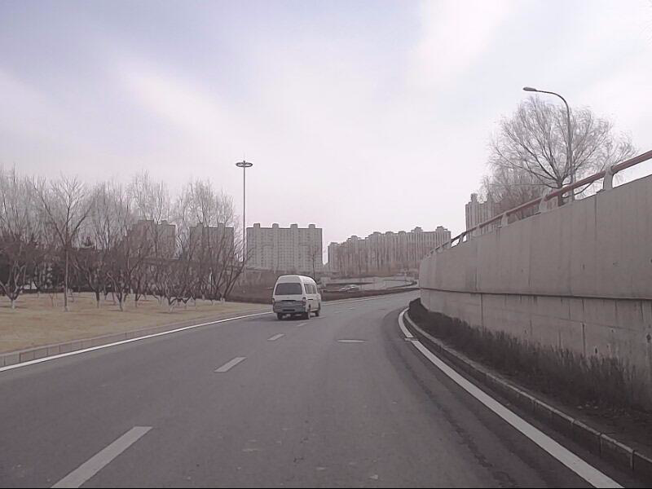
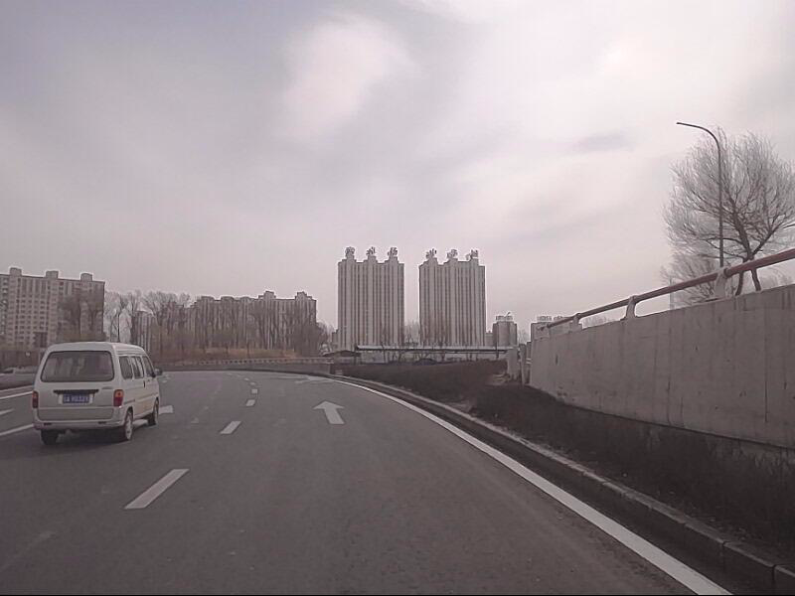
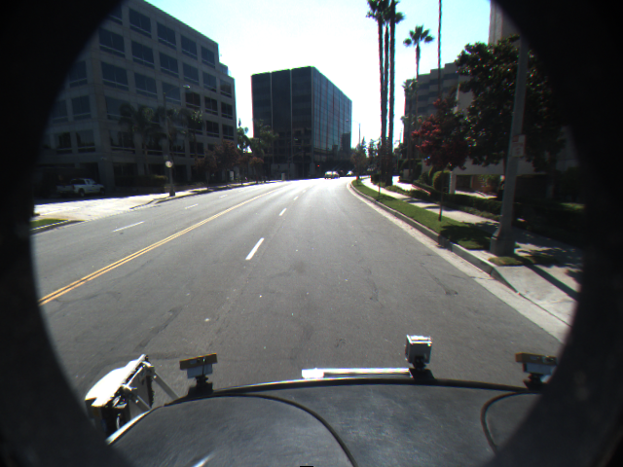
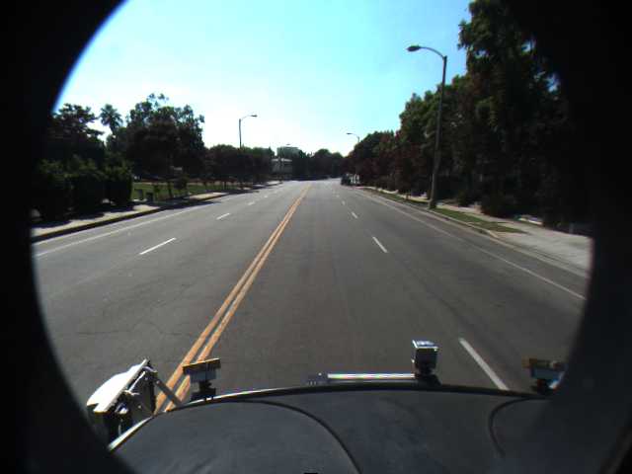
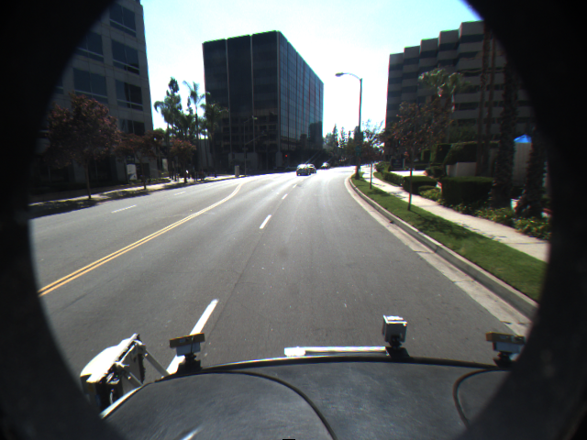

Slide 19
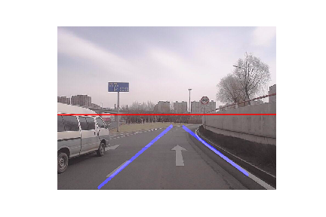
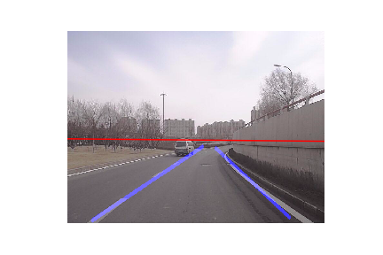
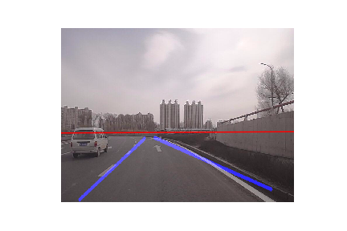
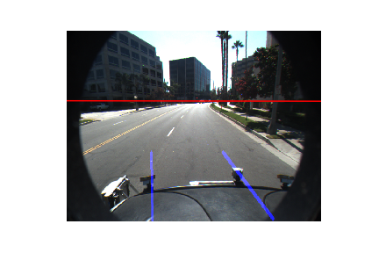
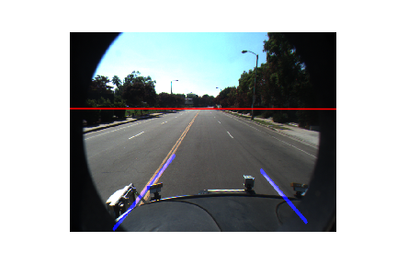
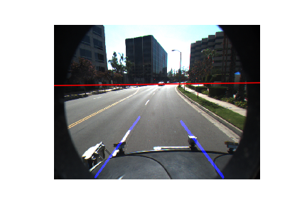
https://github.com/MaybeShewill-CV/lanenet-lane-detection
https://github.com/scottworkman/deephorizon

